Slide 1
Grand Strategy
Selection Matrices

Slide 2
Strengths and Weaknesses
In their seminal text on Strategic Management, Pearce and Robinson define strengths and weaknesses as follows:
Strength: “A resource, skill, or other advantage relative to competitors and the needs of markets a firm serves or anticipates serving. A strength is a distinct competence that gives the firm a comparative advantage in the marketplace. Financial resources, image, market leadership, and buyer/supplier relations are examples” (p. 293).
Weakness: “A limitation of deficiency in resources, skills, and capabilities that seriously impedes effective performance. Facilities, financial resources, management capabilities, marketing skills, and brand image could be sources of weakness” (p. 293).
Example of a strength: Superior market share, excellent inventory turnover (ability to convert inventory into cash), low debt-to-equity ratio, superior equipment, ability to draw highly talented employees, well-known brand image.
Examples of a weakness: Poor market share, poor cash flow, high debt-to-equity ratio, outdated equipment and facilities, inability to draw skilled employees, poor brand image.
Source: Pearce, J.A., & Robinson, R.B. (1988). Strategic management: Strategy formulation and implementation (3rd ed.). Homewood, Il: Irwin.

Slide 3
Opportunities and Threats
Pearce and Robinson define Opportunities and Threats as follows:
Opportunity: “A major favorable situation in the firm’s environment. Key trends represent one source of opportunity” (p. 282).
Threat: “A major unfavorable situation in the firm’s environment” (p. 282).
Examples of an opportunity might include the identification of a new market segment, changes in laws or regulations governing an industry, the exit of a competitor from the industry, high consumer demand (resulting in a decrease in the bargaining power of buyers), and a reduction in price of raw materials (resulting in a decrease in the bargaining power of suppliers).
Examples of a threat might include the advent of new laws or regulations in an industry, the entry of a new competitor into the industry, slowing market growth, or increased bargaining power of suppliers (because of a decrease in the supply of raw materials) or an increase in the bargaining power of buyers (due to decreased demand for a product or service).

Slide 4
SWOT Analysis Diagram
Critical internal
Weaknesses
Numerous environmental opportunities
Cell 3: Supports a turnaround strategy
Cell 1: Supports an aggressive strategy
Substantial
internal
strengths
Cell 4: Supports a defensive strategy
Cell 2: Supports a diversification strategy
Numerous environmental threats

Slide 5
SWOT Analysis Diagram: Generic Strategies (Part 1)
Turnaround strategies: Organization has critical internal weaknesses; numerous opportunities exist in the external environment. These organizations should pursue a turnaround strategy to minimize the internal weaknesses so that they can take advantage of the environmental opportunities. Turnaround strategies include retrenchment, which allows the organization time to address its internal weaknesses (these might include human, capital, and/or financial weaknesses) so that they may take advantage of environmental opportunities. These companies might also pursue vertical integration or conglomerate diversification strategies.
Defensive strategies: Organization are in the least favorable situations when they have critical internal weaknesses and major threats exist in the external environment. These organizations should pursue a defensive strategy such as divestiture of a business line or even full liquidation.

Slide 6
SWOT Analysis Diagram: Generic Strategies (Part 2)
Diversification strategies: These organizations face numerous environmental threats, but they also have internal strengths. These organizations are able to use their internal strengths (resources) to combat the environmental threats. Companies that diversify pursue horizontal integration, concentric diversification, and joint venture strategies.
Aggressive strategies: These organizations are in the most favorable position, as they have many internal strengths and have many environmental opportunities. Aggressive strategies include concentration, market development, product development, and innovation strategies.

Slide 7
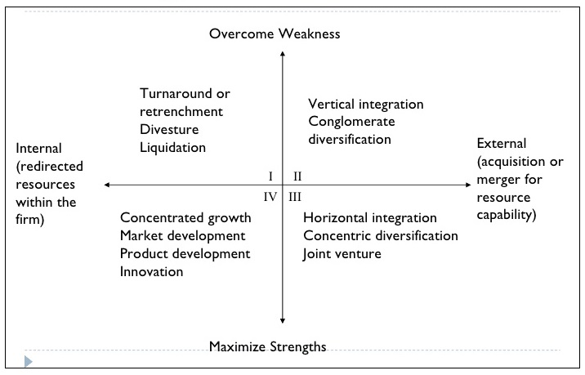
Grand Strategy Selection Matrix
The Grand Strategy Selection Matrix uses two key factors in the selection of a grand strategy (or strategies):
X-Axis: Internal vs. External orientation:
An internal orientation is selected when a company has either significant strengths or significant weaknesses. In an internal orientation, the company looks inward to exploit its strengths or to minimize weaknesses; and
An external orientation is selected when the organization has significant external environmental opportunities.
Y-Axis: Overcome weaknesses or maximize strengths.
Source: Pearce, J.A. (1982). Selecting among alternative grand strategies. California Management Review, 30(2), 29.

Slide 8
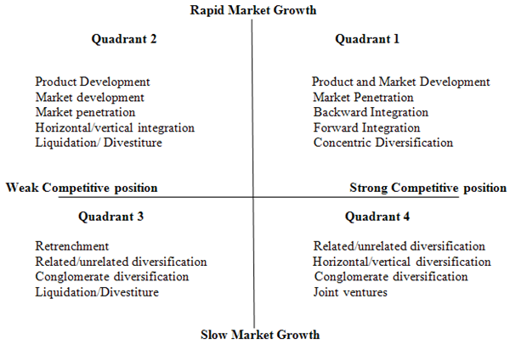
Model of Grand Strategy Clusters
The Model of Grand Strategy Clusters uses Market Growth (slow vs. rapid) and Competitive Position (weak vs. strong) as key factors for strategic choice.
Example:
A company that is in a rapid and high-growth market (i.e., it is competing in and industry that is early on in its life cycle) and that has more strengths than weaknesses (strong competitive position) would fall into Quadrant 1. Companies that fall into Quadrant 1 are in an excellent strategic position, and might choose a Product Development, Market Development, or even a Market Penetration grand strategy.
Source: Thompson, A.A., & Strickland, A.J. (1987). Strategic management: Concepts and cases (4th ed.). Plano, TX: Business Publications.

Slide 9
GE/McKinsey Matrix
Market Attractiveness
A company that is competing in a highly attractive market but that has weak business strength (the company has many weaknesses), would use a “Hold” strategy (this would be comparable to a company in the “Question Mark” cell of the BCG Matrix).
A company that competes in a highly attractive market and that has many strengths would choose a “Grow” strategy (similar to the “Star” cell of the BCG Matrix).
Business Strength
 | High | Medium | Low
Strong | Grow | Grow | Hold
Average | Grow | Hold | Harvest
Weak | Hold | Harvest | Harvest

Slide 10
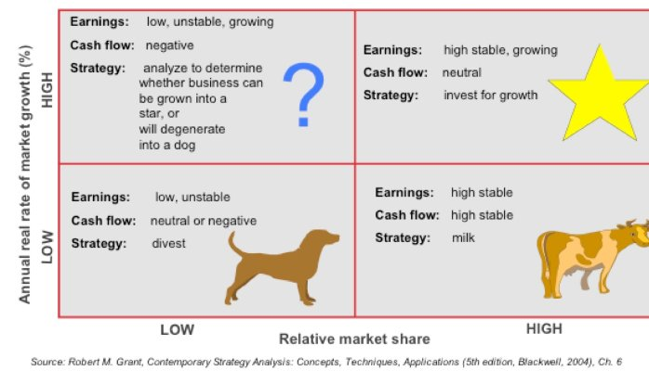
BCG Matrix

